Slide 1

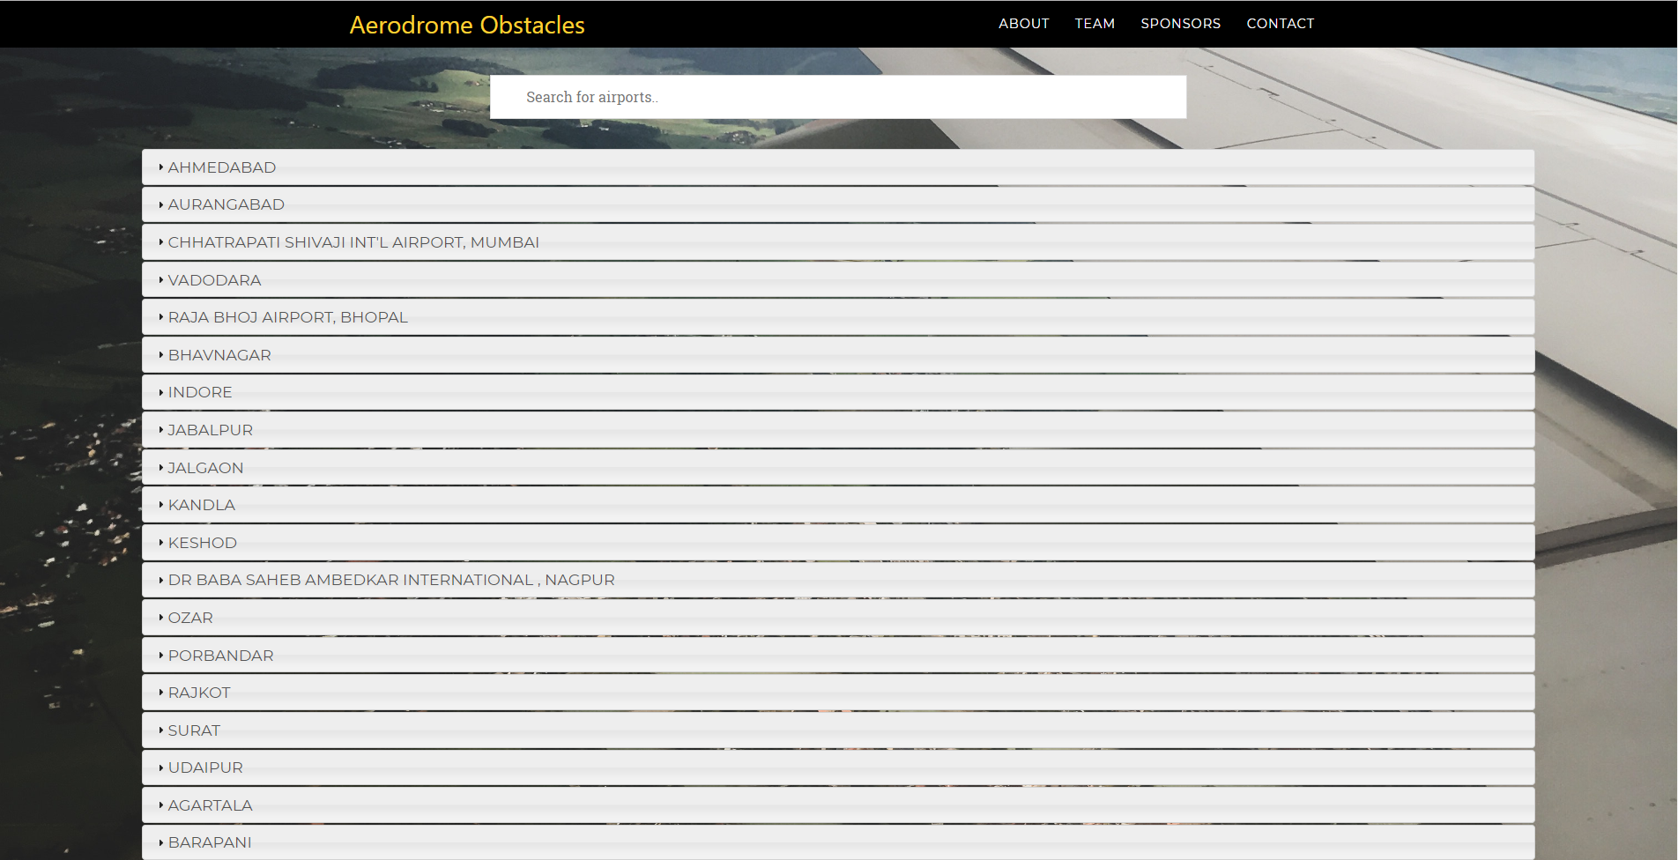

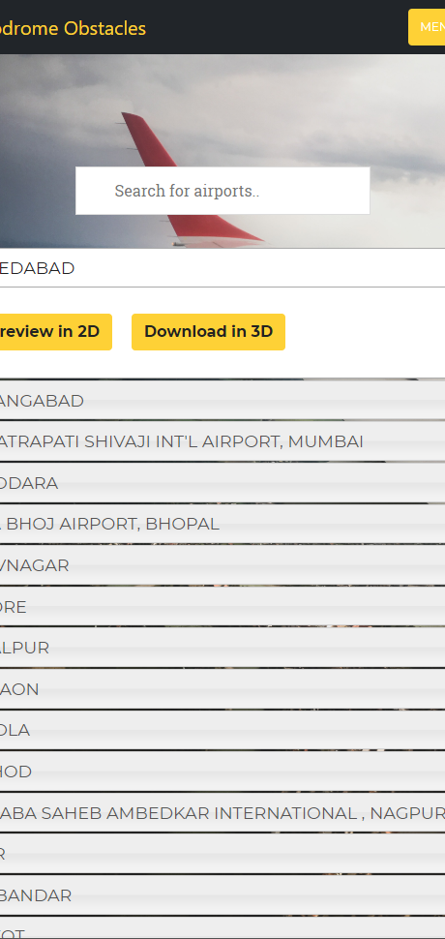
Representing Aerodrome Obstacles
Team Vortex
Smart India Hackathon 2019
Courtesy of Min. of Civil Aviation, India

Slide 2
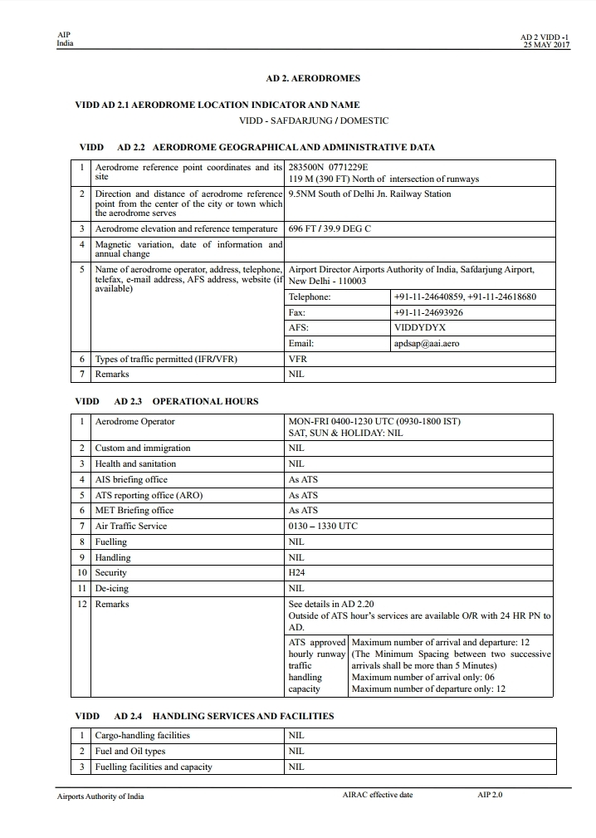
Current Situation:
Records of tall structures located around an aerodrome are maintained in AD 2.10 section of the AIP documentation.
The current version of AIP can be downloaded from the AAI website in PDF document format.
The PDF lists every obstacle with its latitude, longitude, elevation & it's description in a tabular format.

Slide 3
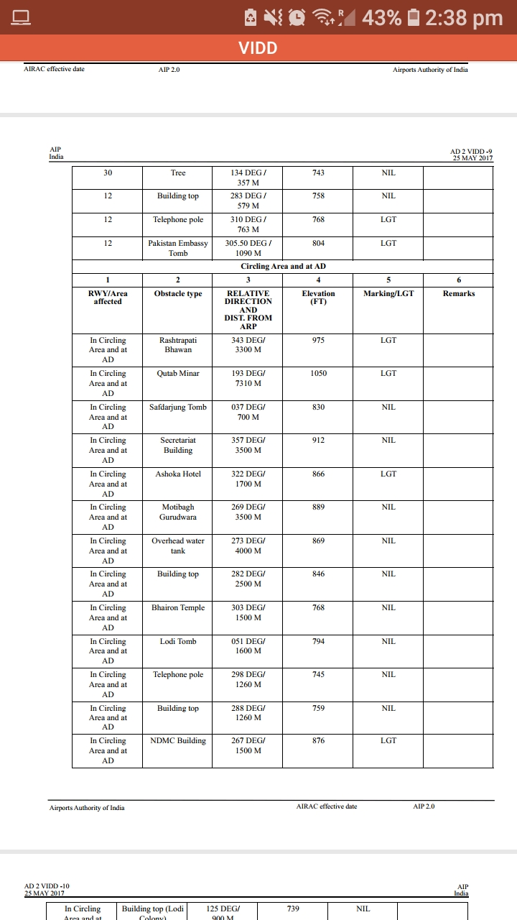
Current Representation :
The current representation of geographic data in latitude, longitude format is very inconvenient for the interpreter to pinpoint the obstacles in field especially the common obstacles like group of trees, electric poles, etc.

Slide 4
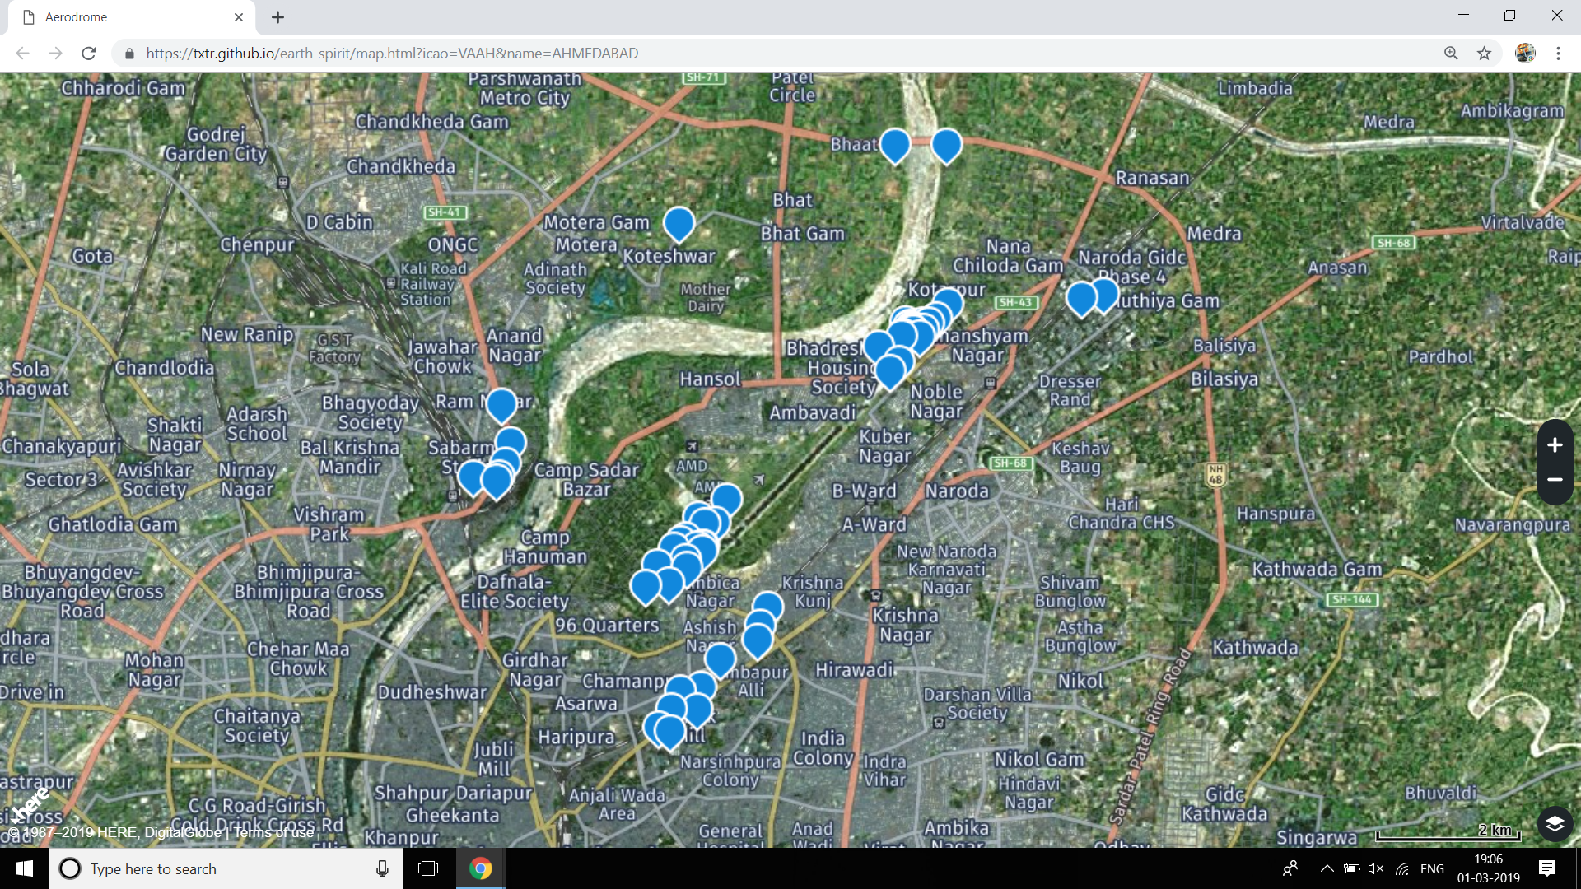
Better solution:
Using open-source geolocation data handling file format like KML, the data of aerodrome obstacles can be conveniently represented on every popular 2D or 3D mapping engine like the Google Earth Engine.

Slide 5
Demonstration of the Solution:

Slide 6
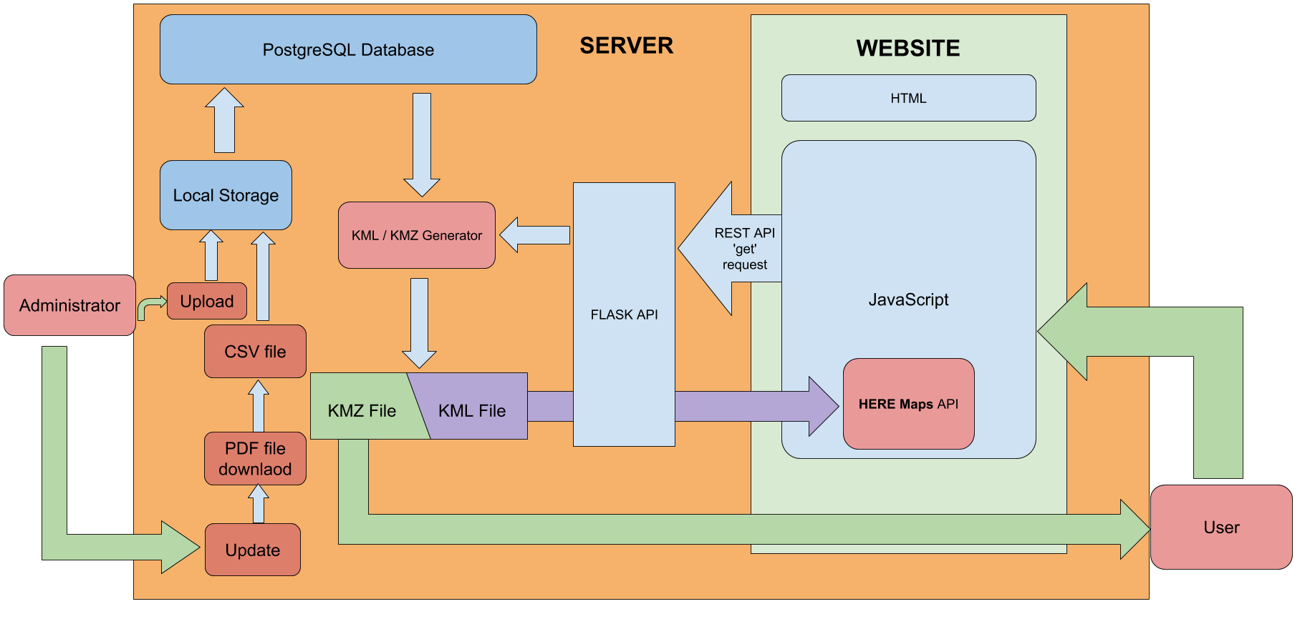
Block Diagram:

Slide 7
C# program downloads and scrapes PDF files to form corresponding CSV files.
The generated CSVs are then added to our RESTful API server database.
KML and 3D Object files are then generated dynamically along with their metadata using the server database using RESTful API .
KMZ files are stored in a file handling server that provides Network Links to various KMZ files.
User downloads the Network Link from the website for 3D which is exported on a Google Earth Platform.
User has an option to see the Aerodrome obstacles in 2D format that is on Maps API.
Advance searching is implemented wherein the user can filter his search parameters and see the obstacles in List, 2D or 3D formats.
Administrators have a login page wherein he/she can update the system or import a CSV file.

Slide 8
REFERENCE
1.] Keyhole Markup Language (KML) : XML based file format to encode geographic
data.
2.] Keyhole Markup Zipped (KMZ) : Compressed file that stores KML files and
3D object files as a single entity.
3.] Network Link : Hyperlinks that link to KMZ files hosted on the
server.
4.] 3D Object Files : Store 3D object models and textures
5.] Google Earth Platform : GUI platform that renders KMZ files in a
user-friendly interface.
6.] File Handling Protocol : Protocol that hosts files on the server.
7.] RESTful API : A RESTful API is a method of allowing
communication between a web-based client
and server that employs representational state
transfer (REST) constraints.
8.] Here Maps :

Slide 9
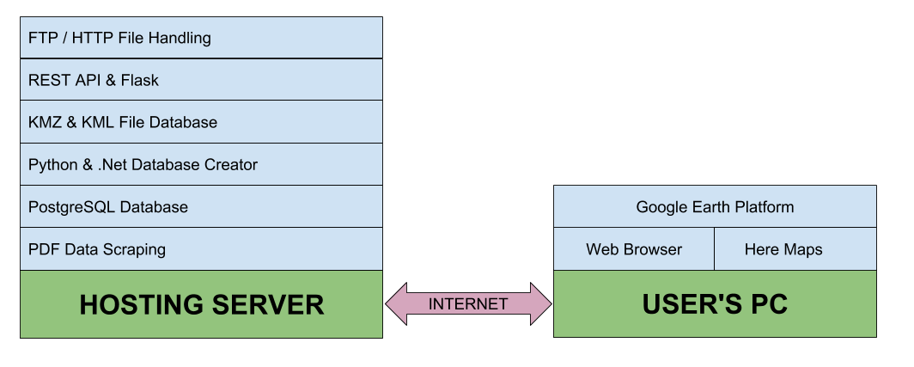
Technology Stack

Slide 10
Dependencies:
File Hosting to save KMZ and KML files.
Computational prowess capable of constructing 3D objects and compress files.
Internet connectivity between file hosting server and end user for synchronizing data.
Updation of obstacle database with a good frequency for prevent backlogging or redundancies as well as for avoiding data from being obsolete.
Publishing of obstacle data in 'AD 2.10 in AIP' in a data-extraction friendly format such as .xls, .csv, .xml would help us to create much more streamlined application to display obstacles around an aerodrome.
More accurate metadata such as shape, width and height dimensions of obstacles would improve the accuracy this solution.
Downloading Google Earth Platform for viewing obstacles in 3D format.

Slide 11
THANK YOU

